Slide 1
Sprockell
A simple processor in Haskell

Slide 2
Just like real hardware?
No…
  pipelining
  caches
  hyperthreading
  …
So really, a simple processor!

Slide 3
Source?
https://github.com/martijnbastiaan/sprockell
Including wiki, docs, …
Referred to as source
Report found issues at github!
  (You can even submit pull requests ;-))

Slide 4
Source layout
src/Sprockell/
  TypesEtc.hs From simple..
  Sprockell.hs
  System.hs
  Components.hs ..to possibly magic
src/
  Demo*.hs
  Tests.hs

Slide 5
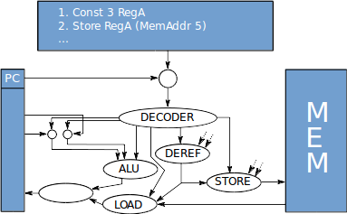
source
source
source
source
source
* Not all components are shown

Slide 6


Slide 7
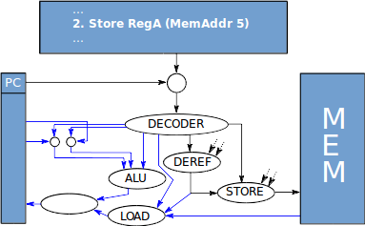
????

Slide 8
Decoder emits defaults
Store: to register Zero
Deref: from register Zero
ALU: XOR with zero
…
source

Slide 9
Challenge
Write a (useful) instruction which employs multiple components at once
  (+optimizer?)

Slide 10
Registers
Zero
PC → Program Counter
SP → Stack Pointer
SPID → Sprockell ID
RegA, RegB, …, RegE
source

Slide 11
Instructions
source
wiki

Slide 12
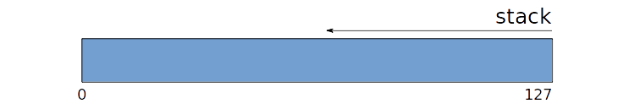
Stack
source

Slide 13
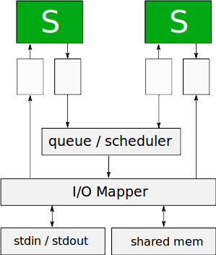
Fast
delay
Ratio
source
Slow
source
source
source

Slide 14
Running it
nSprockells :: Int
prog :: [Instruction]
debugFunc :: SystemState → String
run nSprockells prog
runDebug debugFunc nSprockells prog
Both pick a seed at random

Slide 15
Random behaviour
runWithSeed
runDebugWithSeed
Same as runSeed / runDebug, but first argument a seed

Slide 16
Small example
ghc example.hs
./example

Slide 17
Changing the Sprockell
You're free to do it!
Example: mem <~= (addr, value)
Type | Read | Write
Registers | ! | <~
Memory | !!! | <~=

Slide 18
End notes..
Please report bugs on github if you find one
Detailed instructions are on the wiki

